Slide 1
ABC Online Store
Name: Dhruv patel

Slide 2
Describing the ABC Online Store
The online store currently lets you buy DVDs for different movies and TV shows.
The back end is designed in a way so that new items like Laptops, Phones etc can also be sold if the company decides to do so in the future.
The store allows new members to register and place orders on the site.
Users are required to login to add items to their cart and place orders.

Slide 3
Two parts of this project
1. The Web App:
Allows the uses to login, place orders, register, browse the catalog etc.
2. The Windows App:
Lets the business owners add new items and browse through or delete previous orders that were placed by the Web App uses.

Slide 4
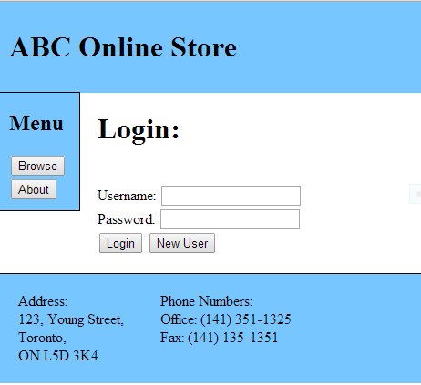
The login page – Web App
A Simple login page that allows the current users to login and start a new session.
Gives an option for the new users to register to the site so that they can add items to their carts and place orders

Slide 5
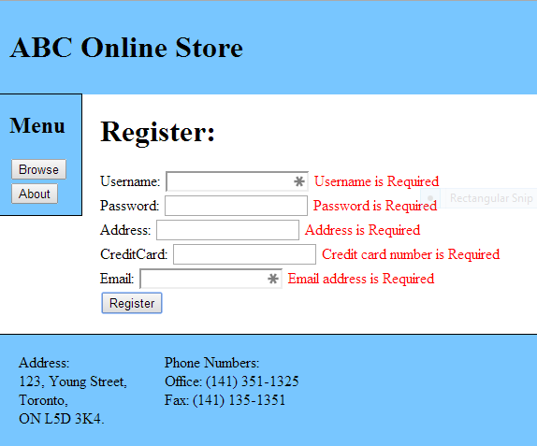
Register – Web App
This page allows new members to register to the site with their new username, password, email address etc.
Has a simple data validation in place so that a blank form is not sent to the server.

Slide 6
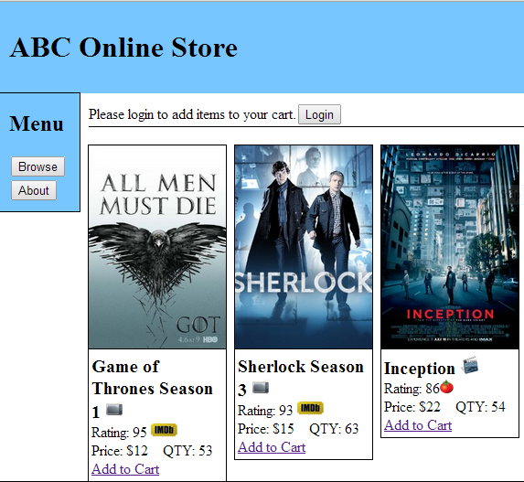
Browse – Web App
Shows all the items that are currently for sale on the store.
Adds an icon next to the item name to describe the category in which the item belongs
Pulls up item rating in real time, from different sites depending upon the type of item.
Rotten tomato for movies
IMDB for TV Shows

Slide 7
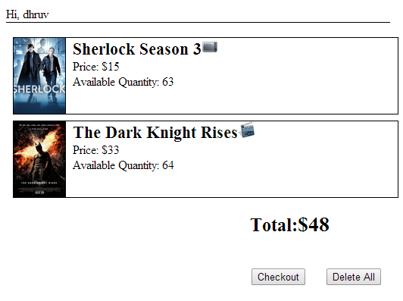
Checkout – Web App
Gives an overview of all the items that the user has added to his/her cart.
Allows them to remove all the items from the existing cart.
User can decide to place the order by pressing the Checkout button.
Uses operator overloading to calculate the total price.

Slide 8
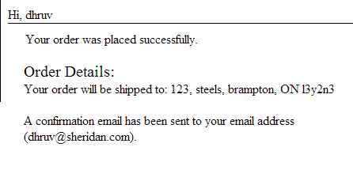
Confirmation – Web App
The user is redirected to a confirmation page that will show them their shipping address and also a notification is sent to the users email address.

Slide 9
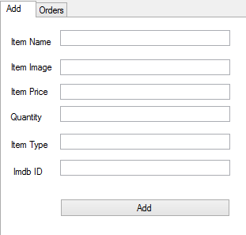
Add Item – Windows App
Lets the business owners to add a new item to their catalog.

Slide 10
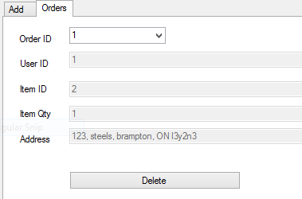
Orders – Windows App
The business owners can delete shipped orders using the Orders tab of the windows app

